Slide 1
Feeder
LOGO

Slide 2
Feeder
- Priti Mainkar
Guide- Monali Deshpande
Feeder is a NGO management and Donation system. it provides a platform for people who want to volunteer for Social Causes, as well as a service for people who want to help the society by making donations. NGOs and Orphanages are always in need of donations in the form of money, clothes, books, food and utilities. This application provides room for these organizations, donors and volunteers to shake hands under one roof.

Slide 3
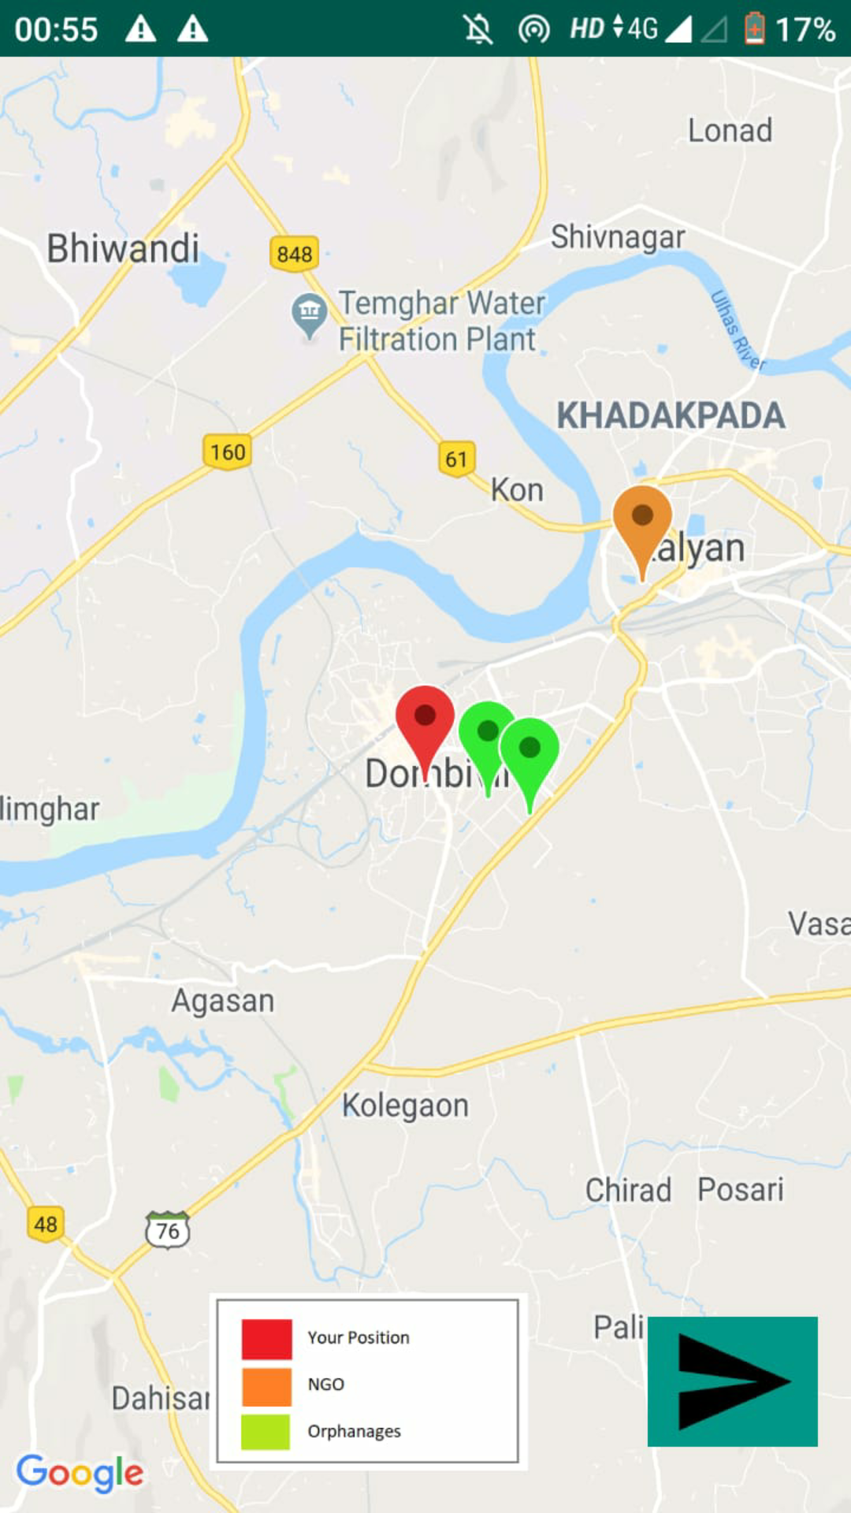
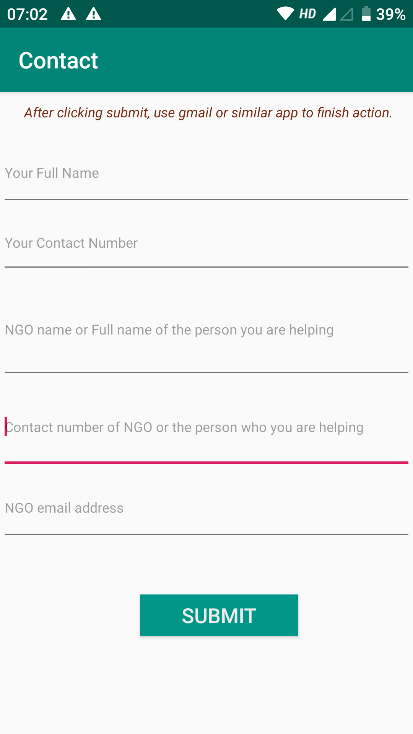
Stakeholders


Volunteers
NGOS and
Orphanages
⬄
Donors

Slide 4
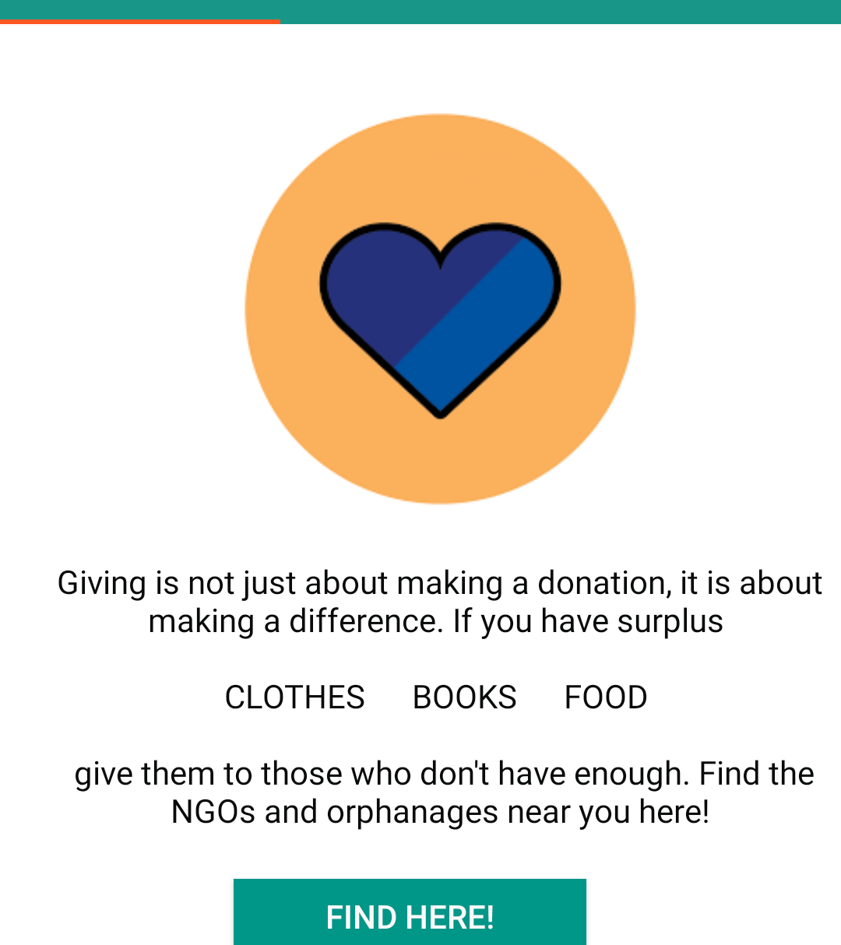
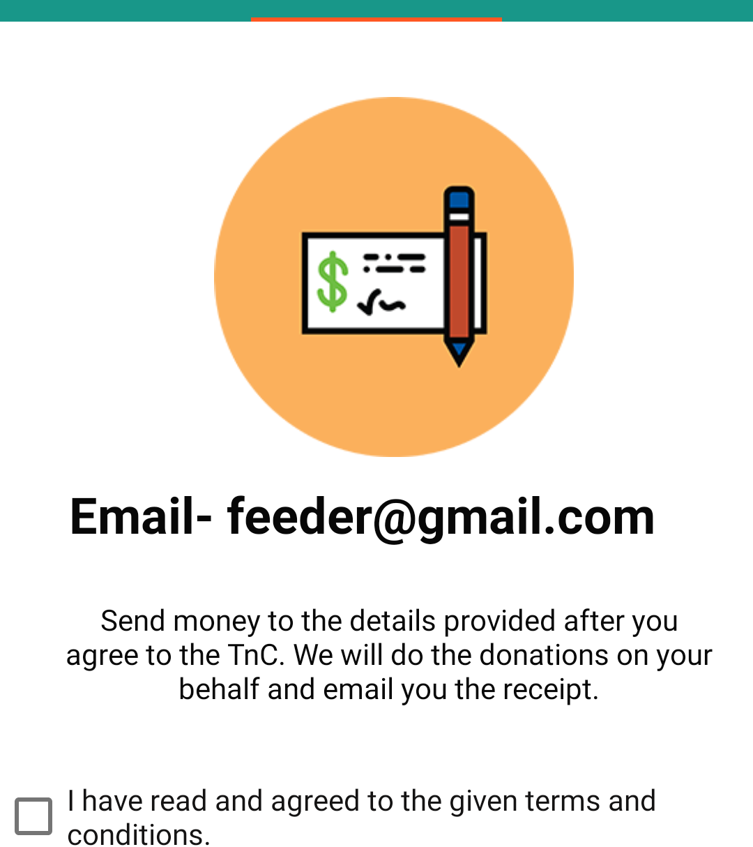
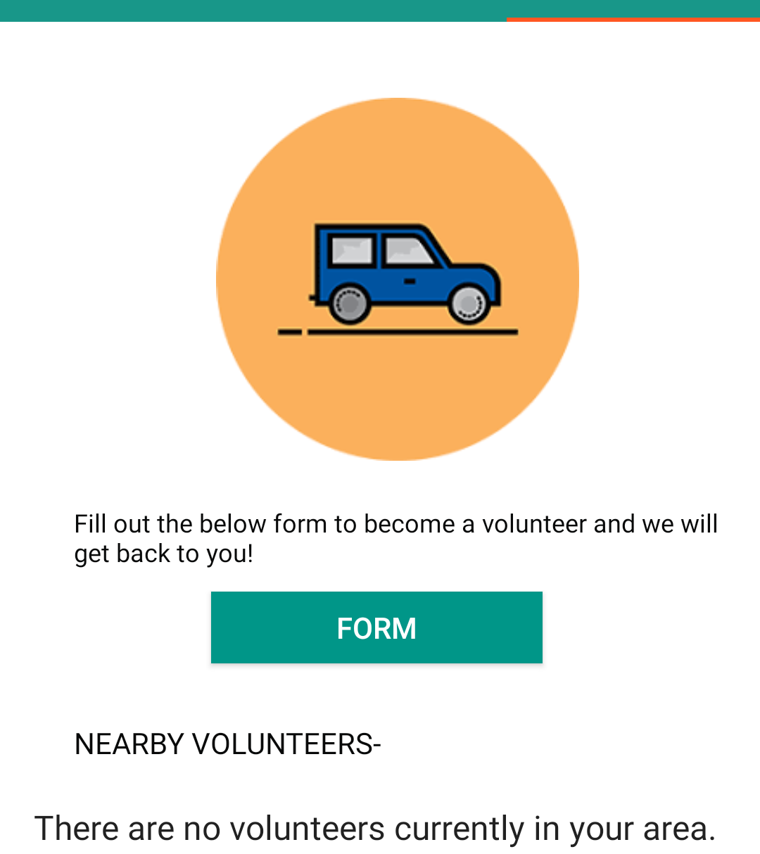
Features
Find Donation Spots Near You
Make direct Monetary Donations
Volunteer for Social Causes As well as Find
Nearby Volunteers

Slide 5
Past, Present and Future.
1
2
Existing System
Proposed System
The existing system is not very effective as all the processes of finding volunteers and making donations is manual and time consuming. There was lack of platform where organization, donors and volunteers could find each other.
The proposed system allows users to locate the exact location of verified organisations, nearby volunteers and how to get in touch with them as well as provides service for instant monetary donations.
3
4
Future Enhancements
Maintenance
The future plans for the system are that we will add chat functionality, improve security level and increase the number of organisations on the map. We also plan to add a feature to allow people to start campaigns for people in immediate need of large amount of money.
The system requires minimum maintenance. It only needs to be updated with new volunteers and organisations. For the time being, we aspire to do it manually. Over time, we plan to collaborate with verified volunteers and maintain the platform by their help.

Slide 6
Feeder
THANKS

